Slide 1
Generating SQL queries from NL descriptions
Zhang Huangzhao, Yuanpei College
Zhang_hz@pku.edu.cn

Slide 2
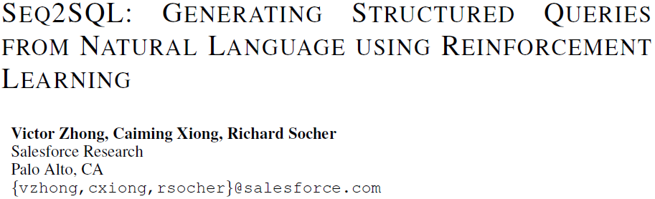
REJECTED

Slide 3
Outline
Task & difficulties
Introduction to sequence generation
Sequence completion by RNN / LSTM
Seq2seq framework
Ptr-Nets
Seq2SQL (the paper)
Model: Aggregation operation + SELECT column + WHERE clause
Augmented Ptr-Nets
Dataset: WikiSQL
Evaluation & result

Slide 4
Task: to generate SQL query
Seq2seq-based models have achieved a lot in many fields.
NLP: machine translation, automatic QA, machine comprehension, etc.
Programming language: API completion, code-comment generation, etc.
‘Translation’: NL description -> SQL query.
A dream
‘Which clerk lives in the same city with his or her manager, and earns more than the average salary?’
‘SELECT blabla FROM blabla(SELECT blabla FROM blabla WHERE blabla)blabla WHERE blabla(SELECT blabla FROM blabla WHERE blabla)blabla’.

Slide 5
Advantages vs. difficulties
Advantages
Previous models perform well in other fields, such as NLP.
Strict structure, such as SELECT FROM WHERE.
SQL queries are usually short.
Almost all tokens are in the NL description / DB structure
…
Difficulties
Very strict structure
Nested SQL?
Verbose NL description?
…

Slide 6
Modified task
To generate simple SQL queries from not-very-long NL descriptions.
The SQL query structure is strongly restricted.
“SELECT [column names] FROM [table names] WHERE [where clause] AND/OR [where clause] AND/OR …”
The NL descriptions are not too verbose.
Only one table in the database.
Only one column required in the query.

Slide 7
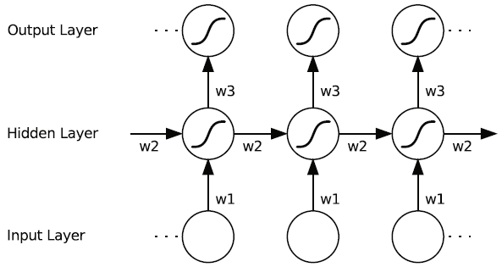
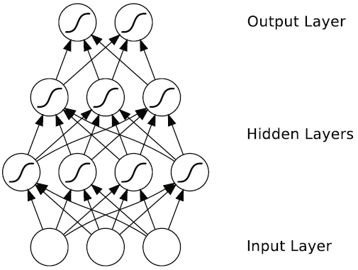
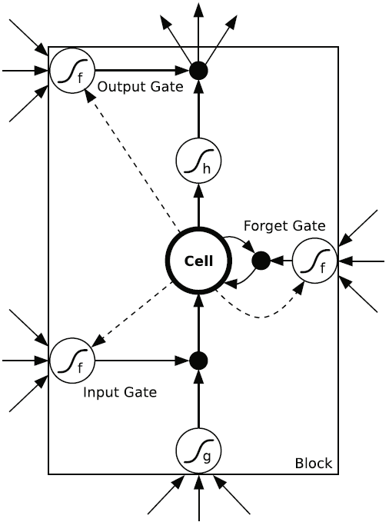
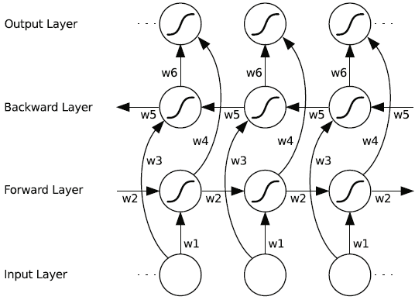
Introduction to RNN & LSTM
MLP
RNN
Bi-RNN
LSTM
Bi-LSTM
Graves A. Supervised Sequence Labelling with Recurrent Neural Networks[M]. Springer Berlin Heidelberg, 2012.

Slide 8
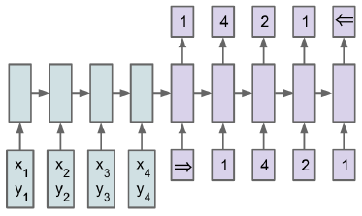
Introduction to seq2seq
2 sequence sub-models.
The encoder encodes the input sequence, and generates the ‘intermediate vector’.
The intermediate vector contains all information the decoder should be aware of.
The decoder takes in the intermediate vector as initialized hidden state, and generates the output sequence.
Vinyals O, Fortunato M, Jaitly N. Pointer Networks[J]. Computer Science, 2015.

Slide 9
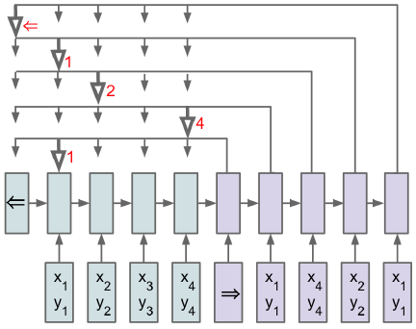
Introduction to Ptr-Nets
The encoder and the intermediate vector are the same as seq2seq.
For each timestep, the decoder choose the proper token from the input sequence and generate it as the output of this timestep.
‘Properness’ is generated using attention mechanism.
Vinyals O, Fortunato M, Jaitly N. Pointer Networks[J]. Computer Science, 2015.

Slide 10
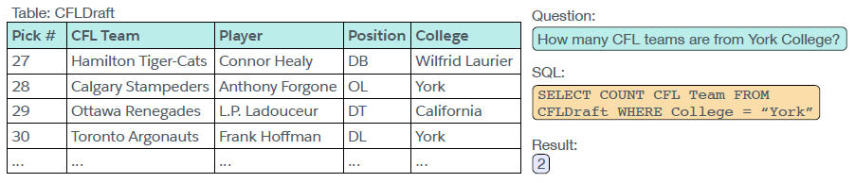
Augmented Ptr-Nets
SQL query tokens.
The NL question.
The column names.
The SQL key words.
Augmented input sequence = columns + key words + question.

Slide 11
Augmented Ptr-Nets (2)
Ptr-Nets on the augmented input sequence.
Capable to generate SQL queries.
Incapable to leverage the structure inherent in SQL.
Aggregation operation
Column names in the SELECT column(s)
Regarding ‘A AND B’ and ‘B AND A’ as different WHERE clauses.

Slide 12
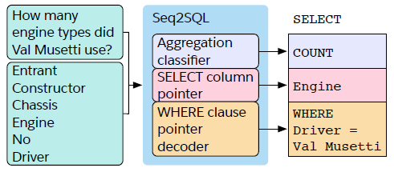
Augmented Ptr-Nets (3)

Slide 13
Seq2SQL
A typical SQL query:
SELECT COUNT xxx FROM … WHERE xxx AND xxx AND …
Modules
Aggregation classifier
SELECT column pointer
WHERE clause pointer decoder
The modules are based on attention mechanism and augmented Ptr-Nets

Slide 14
Seq2SQL (2)
Aggregation operation
Decide whether to use aggregation or not.
Compute the attention score over the augmented sequence
Linearly combine the tokens in the augmented sequence, using the attention score as combination weight.
MLP classification upon the combination result.
Classification targets are [COUNT, MIN, MAX, …, __NO_AGGREGATION__]

Slide 15
Seq2SQL (3)
SELECT column pointer
Choose the most suitable column in the table columns.
Compute vector representation for each column using LSTM.
Combine the augmented sequence similarly in ‘Aggregation operation’.
MLP classification.
WHERE clause pointer decoder
Generate the where clauses.
Augmented Ptr-Nets.

Slide 16

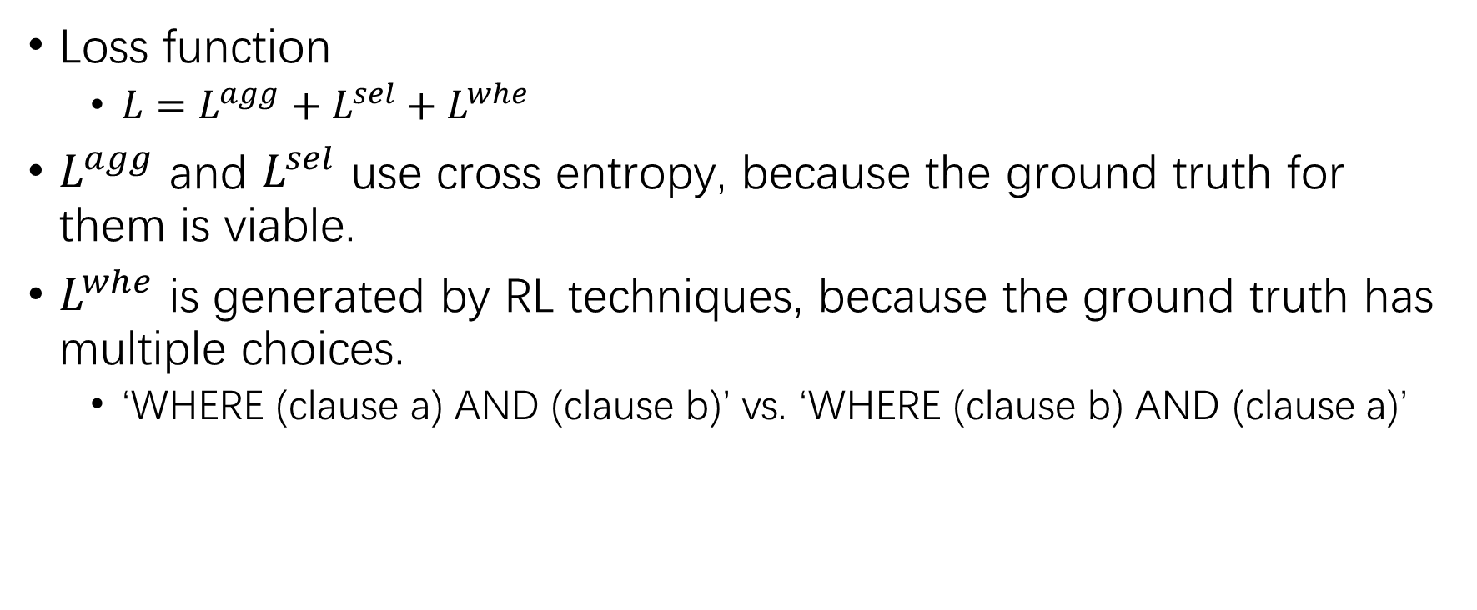
Seq2SQL (4)
Loss function
$L=L^{agg}+L^{sel}+L^{whe}$
$L^{agg}$ and $L^{sel}$ use cross entropy, because the ground truth for them is viable.
$L^{whe}$ is generated by RL techniques, because the ground truth has multiple choices.
‘WHERE (clause a) AND (clause b)’ vs. ‘WHERE (clause b) AND (clause a)’

Slide 17
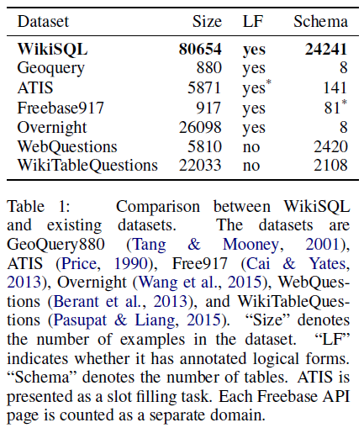
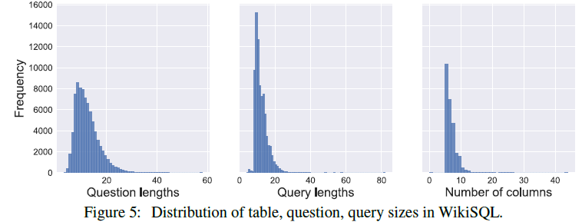
Dataset
WikiSQL – A collection of questions, corresponding SQL queries and SQL tables.

Slide 18
Evaluation
Execution accuracy:
Logical form accuracy:
Because acc_{lf} penalizes correct queries different from the ground truth, it is used only to evaluate the model, instead of training.

Slide 19
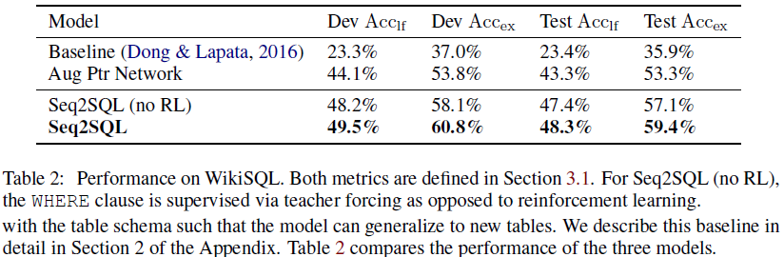
Result

Slide 20
Inspirations & Weaknesses
Inspirations
Make full use of the existing works, and maybe 1 + 1 > 2.
Combine multiple well designed modules, when the single universal model is incapable the task.
Use RL when the loss function is not viable.
…
Weaknesses
Although the task is interesting, the model is lack of innovation.
The modules are too specific, and the model is not transferrable.
…

Slide 21
My thoughts
Pretrain the sequence generation model before training, and force it to generate sequences in the form of “SELECT FROM WHERE”. Hopefully, the pretraining can help with the generated query structure.
Use manually set filters/masks in the output layer to help maintaining the correctness of the query structure.
Apply tree-based RNN/LSTM to generate nested SQL queries.
…

Slide 22
References
Zhong V, Xiong C, Socher R. Seq2SQL: Generating Structured Queries from Natural Language using Reinforcement Learning[J]. 2017.
Graves A. Supervised Sequence Labelling with Recurrent Neural Networks[M]. Springer Berlin Heidelberg, 2012.
Vinyals O, Fortunato M, Jaitly N. Pointer Networks[J]. Computer Science, 2015.

Slide 23
THANK YOU!

